Slide 1

OBE Implementation - Course Utilization Module
Submitted by:
Aaryan Regmi AP23110011208
Yajnesh Ande AP23110011209
Geetesh Kovelamudi AP23110011189
Sheldon Castelino AP23110011179
Rajavardhan Kasa AP23110011182
Karthikeya Maddimsetty AP23110011188

Slide 2
Introduction
Our University (SRM-AP) is implementing OBE (Outcome Based Education), and this project focuses on developing a Course Utilization module as part of the larger OBE system. The module is implemented in C programming language and incorporates searching and sorting algorithms for efficient data management. The system allows for basic CRUD operations (Create, Retrieve, Update, Delete) while implementing and comparing different algorithmic approaches.

Slide 3
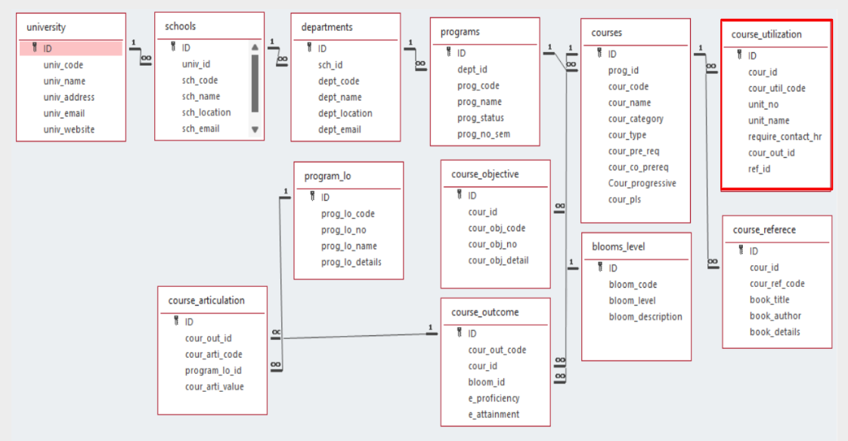
Architecture Diagram

Slide 4
Module Description
The Course Utilization module manages course utilization details including course IDs, utilization codes, unit information, and contact hours. It provides CRUD operations with additional features for sorting and searching records. All data is persistently stored in a text file.
Programming Details and Naming Conventions
File Name: course_utilization_setting.txt
Function Names:
Create: optiminds_course_util_create
Update: optiminds_course_util_update
Retrieve: optiminds_course_util_retrieve
Delete: optiminds_course_util_delete
Sorting: optiminds_course_util_insertion_sort
Searching: optiminds_course_util_linear_search
Storing: optiminds_course_util_store
Loading: optiminds_course_util_load

Slide 5
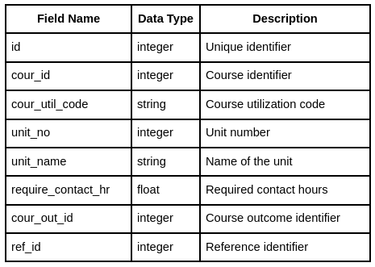
Field/Table Details

Slide 6
Algorithm Details- Sorting
Implementation: Insertion Sort
Process:
Start from the second element
Compare with previous elements
Shift larger elements right
Insert current element in correct position
Repeat for all elements
Time Complexity: O(n²)
Best Case: O(n) when array is already sorted
Average Case: O(n²)
Worst Case: O(n²) when array is reverse sorted

Slide 7
Algorithm Details - Searching
Implementation: Linear Search
Process:
Start from first element
Compare with target value
If match found, return position
If not found, move to next element
Repeat until found or end of array
Time Complexity: O(n)
Best Case: O(1) when element is at beginning
Average Case: O(n/2)
Worst Case: O(n) when element is at end or not present

Slide 8
Insertion Sort vs Selection Sort
Think of insertion sort like arranging playing cards in your hand. As you pick up each card, you insert it into its correct position among the cards you're already holding.
procedure insertionSort(array)
for i from 1 to length(array) - 1
key = array[i]
j = i - 1
while j >= 0 and array[j] > key
array[j + 1] = array[j]
j = j - 1
array[j + 1] = key
Selection sort works by dividing your array into a sorted and unsorted portion. It repeatedly finds the smallest element from the unsorted portion and adds it to the end of the sorted portion.
procedure selectionSort(array)
for i from 0 to length(array) - 1
min_idx = i
for j from i + 1 to length(array)
if array[j] < array[min_idx]
min_idx = j
swap array[i] and array[min_idx]

Slide 9
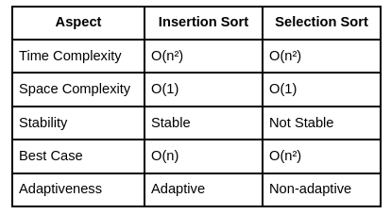
Insertion Sort vs Selection Sort

Slide 10
Linear Search vs Binary Search
Linear search is like checking every locker in a row until you find what you're looking for. It's simple but can be time-consuming for large datasets.
procedure linearSearch(array, target)
for i from 0 to length(array) - 1
if array[i] equals target
return i
return -1
Binary search is like finding a word in a dictionary - you open to the middle and eliminate half the pages based on whether your word comes before or after that page.
procedure binarySearch(array, target)
left = 0
right = length(array) - 1
while left <= right
mid = (left + right) / 2
if array[mid] equals target
return mid
if array[mid] < target
left = mid + 1
else
right = mid - 1
return -1

Slide 11
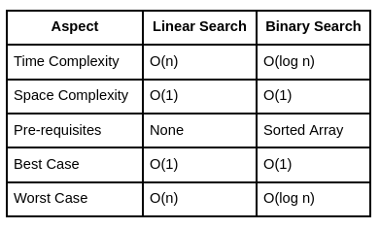
Linear Search vs Binary Search

Slide 12
Sample Source Code
void optiminds_course_util_insertion_sort() {
int i, j;
struct CourseUtilization temp;
for (i = 1; i < record_count; i++) {
temp = records[i];
j = i - 1;
while (j >= 0 && records[j].id > temp.id) {
records[j + 1] = records[j];
j = j - 1;
}
records[j + 1] = temp;
}
printf("Records sorted!\n");
}

Slide 13
Sample Source Code
void optiminds_course_util_linear_search() {
int id;
int i;
int found = 0;
printf("Enter ID to find: ");
scanf("%d", &id);
clear_input();
for (i = 0; i < record_count; i++) {
if (records[i].id == id) {
printf("\nFound Record:\n");
printf("ID: %d\n", records[i].id);
printf("Course ID: %d\n", records[i].cour_id);
printf("Course Code: %s\n", records[i].cour_util_code);
printf("Unit Number: %d\n", records[i].unit_no);
printf("Unit Name: %s\n", records[i].unit_name);
printf("Contact Hours: %.2f\n", records[i].require_contact_hr);
printf("Course Outcome ID: %d\n", records[i].cour_out_id);
printf("Reference ID: %d\n", records[i].ref_id);
found = 1;
break;
}
}
if (found == 0) {
printf("Couldn't find that record!\n");
}
}

Slide 14
Sample Source Code
void optiminds_course_util_store() {
FILE *file;
int i;
file = fopen(FILE_NAME, "w");
if (file == NULL) {
printf("Can't open file!\n");
return;
}
for (i = 0; i < record_count; i++) {
fprintf(file, "%d %d %s %d %s %.2f %d %d\n",
records[i].id,
records[i].cour_id,
records[i].cour_util_code,
records[i].unit_no,
records[i].unit_name,
records[i].require_contact_hr,
records[i].cour_out_id,
records[i].ref_id);
}
fclose(file);
printf("Saved to file!\n");
}

Slide 15
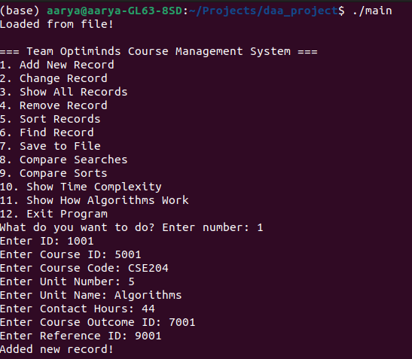
Sample Screenshots

Slide 16
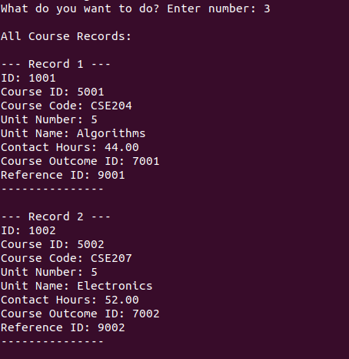
Sample Screenshots

Slide 17
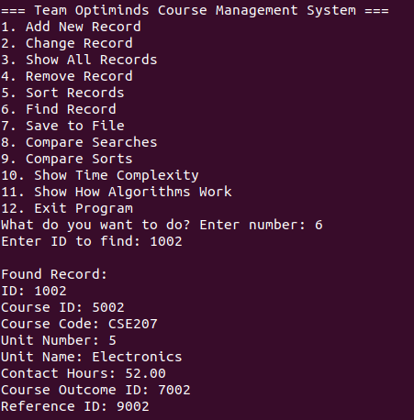
Sample Screenshots

Slide 18
Conclusion
The Course Utilization module successfully implements all required functionality including:
Complete CRUD operations for course utilization records
Efficient sorting using Insertion Sort algorithm
Reliable searching using Linear Search algorithm
Persistent storage using file operations
User-friendly command-line interface
The implementation provides a solid foundation for managing course utilization data within the larger OBE system. The chosen algorithms provide a good balance between implementation simplicity and performance for the expected data volume.

Slide 19
Thank You

